Slide 1
STEP BY STEP GUIDE TO MAKING A KEYFOB
By Katie Jane Spence

Slide 2
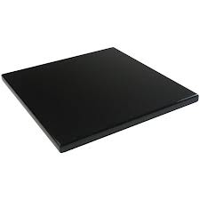
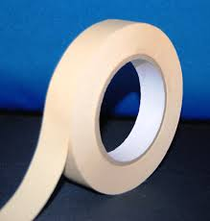
Step 1
The plastic on one side will have a white coating of plastic. Flip the plastic
over and put a piece of masking on the side without the plastic. This means
it will not get scratched or damaged in the vice.

Slide 3
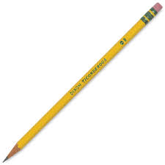
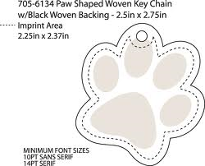
Step 2
Measure and draw on your desired shape of your key fob.
This means you can cut the shape easier and quicker to cut.

Slide 4
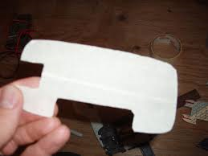
Step 3
Cut out the shape you have drawn on to your masking
tape with a coping saw tightly secured in the vice.

Slide 5
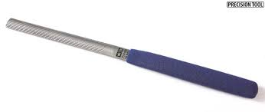
Step 4
Get a round file for plastic and file any rough or sharp
edges or corners away.

Slide 6
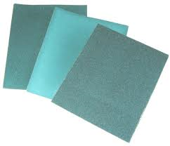
Step 5
Keep your round file and get a small rectangular piece
of wet and dry paper. Wet the piece of wet and dry paper
and file all the sides of the plastic until you have removed
all of the scratches.

Slide 7
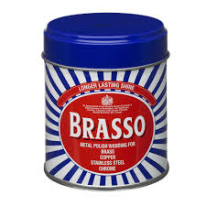
Step 6
Get a piece of cotton wool and soak it in brasso. Go round
every side of the plastic rubbing the brasso soaked piece
of cotton wool up and down them until it looks shiny and polished.

Slide 8
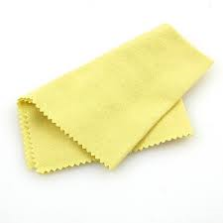
Step 7
Go round the bits of the plastic with the brasso on them
with a cloth and rub hard till dry. Wash the the plastic with
soap and water then dry it.

Slide 9
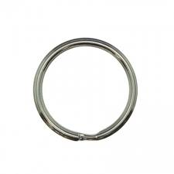
Step 8
Use an electric drill and drill a hole for the key ring to
go through . Put the key ring through the hole and peel
the plastic and masking tape off . Your done and now
you have a fantastic plastic key fob.

Slide 10
By Katie jane spence
Key fob guide

