Slide 1
Wood
S1 / 2
Design & Manufacture
Name: ………………………………………………………… Class:……………… Teacher:…………………………………………..

Slide 2
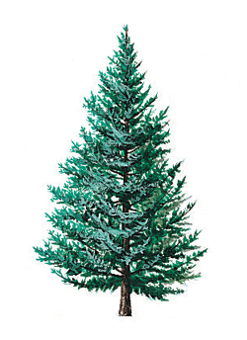
Wood Introduction
Woods can be classified into 3 main groups; Softwoods, Hardwoods & Manufactured Boards.
Name | Properties | Uses | Cost
Red Pine | Straight grained, but knotty, quite strong and easy to work. Red/orange in colour | Building construction. Needs good protection when used outside. | Low
Parana Pine | Straight grained with few knots. Quite strong and durable but warps easily. | High quality interior construction and furniture. | High
Spruce (whitewood) | Quite strong with few knots. Resistant to splitting but not durable. | Fitted furniture e.g. Kitchen cabinets. | Low
Cedar | Straight grained and knot free. Very light and durable. Quite soft | Shed construction and good quality fencing. | High
Softwoods: These come from coniferous trees (trees that have needle like leaves and last throughout the year) these grow quickly and can be replaced quickly after being cut down. Softwoods are
relatively cheap
to buy.

Slide 3
Wood Introduction
Woods can be classified into 3 main groups; Softwoods, Hardwoods & Manufactured Boards.
Name | Properties | Uses | Cost
Ash | Light in colour, flexible, tough bends well and varnishes well. | Tool handles, cricket/baseball bats, snooker cues, ladders and veneers. | Med
Beech | Mid-brown colour, hard, strong, tough, tends to warp but bends well. | High quality furniture, toys, tool handles and veneers. | Med
Oak | Light brown, hard, tough, heavy and durable outside. Gets harder with age. | high quality furniture, garden furniture, boats and veneers. | High
Mahogany | Red in colour, medium weight, quite strong, durable but warps easily. | high quality furniture, shop furniture, boat fittings and veneers. | High
Hardwoods: These come from deciduous trees (trees that lose their leaves every winter). They grow slowly and sometimes have twisted trunks. They are often not replaced when cut down and take a long time to grow. Their
wood is
Expensive
and used for
high quality
products.

Slide 4
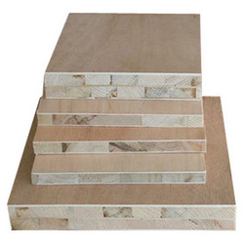
Wood Introduction
Woods can be classified into 3 main groups; Softwoods, Hardwoods & Manufactured Boards.
Name | Properties | Uses | Cost
Plywood | Strong, stable, warps easily. Made by gluing layers of thin sheet wood together. It is important that the grain of each layer goes in a different direction to ensure maximum strength. | Bases of drawers or boxes. Backs of cabinets and wardrobes etc. | Med
MDF | Very strong and doesn’t warp. Made from gluing and tightly compressing excess sawdust together. | Furniture and toys. | Med
Blockboard | Very strong and rigid and doesn't warp. Very heavy. Made from gluing strips/blocks of wood together. | Quality furniture, stage flooring and fire doors. | High
Chipboard | Heavy, warps easily and needs a good finish. Made by gluing and tightly compressing wood chips together. | Kitchen cabinets and worktops, roofing boards. | Low
Hardboard | Not very strong, warps easily and needs a good finish. Made similar to plywood. | Door panels, drawer bottoms and cabinet backs | Low
Manufactured Boards: These are made from waste wood left over from machining or working. All excess such as thin sheets (plywood), small strips/blocks (blockboard), wood chips (chipboard) and saw dust (MDF) are
used to make
boards.

Slide 5
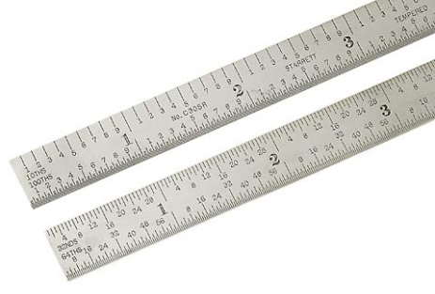
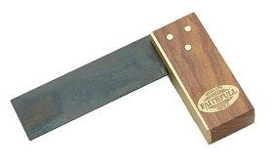
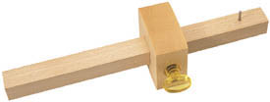
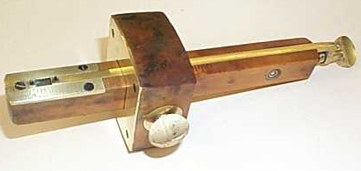
Marking Out Tools
Before you start making anything in the workshop, you will need to mark out any wood working joints and waste wood onto your wood. We use many different marking out tools to do this...
Steel Rule
Try Square
For marking lines at right angles (90 degrees) to an edge of a piece of wood.
For measuring sizes on wood, metal and plastic.
Marking Gauge
For marking lines
parallel to an edge of a piece of wood.
Mortise Gauge
For marking out the width of a mortise hole for a mortis and tenon joint.
Adjustable Spur
Spur
Stock
Adjustment Screw - Adjusts width of the mortise joint.
Fixed Spur
Stem
Thumb Screw
Stem
Stock
Thumbscrew

Slide 6
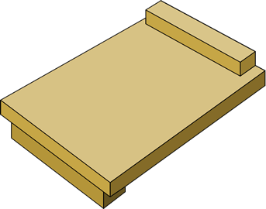
Cutting & Shaping Tools
Once you have finished marking out your job it is time to think about what tools you will need to cut and shape your work.
Saws and Sawing
It is important to note that there are two categories of Saw: Rip Saws and Cross-cut Saws. Rip Saws are used for cutting along the grain.
Cross-cut saws are used for cutting across the grain.
Bench Hook/Sawing Board
A bench hook is an aid to crosscutting small pieces of wood on the bench. As well as helping you to hold the wood in place, it also supports the wood - particularly the small piece that is about to fall off when you've finished cutting.

Slide 7
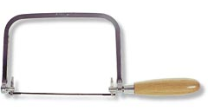
Tenon Saw
Mainly used for cutting out joints in wood. This saw cuts very straight because the blade is very rigid (stiff) due to brass back at the top of the saw. (Cross-Cut Saw)
Coping Saw
A thin saw used for making curved cuts. The blade can be set to almost any angle and is very flexible but can break easily so care and attention must be taken.
Panel Saw
Mainly used for making straight cuts in large pieces of timber. (Rip Saw)

Slide 8
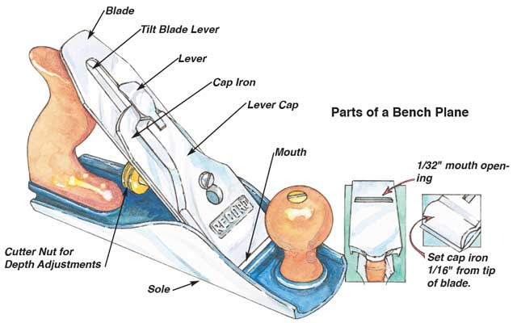
Planes
Plane Safety
- Always ensure that the blade is set correctly to ensure that there is no risk of accident or damage to your wood/plane. Always place your plane side up on the work bench to ensure that the blade does not get damaged.
Smoothing and Jack planes
Although both Jack and smoothing planes look similar they are used for different jobs:
Jack planes are used to make long edges straight and square and are longer than smoothing planes.
Smoothing Planes are used to make surfaces smooth.

Slide 9
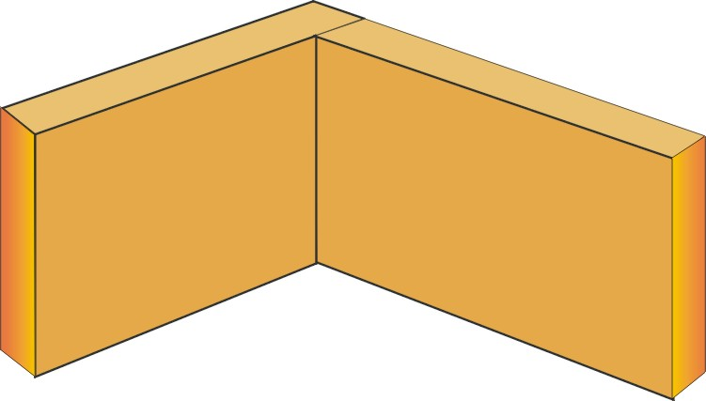
Timber Joints
The majority of joints used in woodcraft have been designed specifically to attain the maximum possible strength in the model they are holding together. The type of joint selected will depend on what is being constructed i.e. what forces are going to be exerted upon the artefact. The selection is also dictated by the final appearance. i.e. in furniture manufacture it is normally important to hide the joint, as a piece of furniture which has a strong joint construction but if the joints are showing it will not be very pleasing to look at and ultimately potential customers would most likely avoid buying such furniture.
Butt Joint
Butt joints are the quickest and simplest to make but are not very strong. They generally need dovetail nailing to increase the overall strength of the joint.

Slide 10
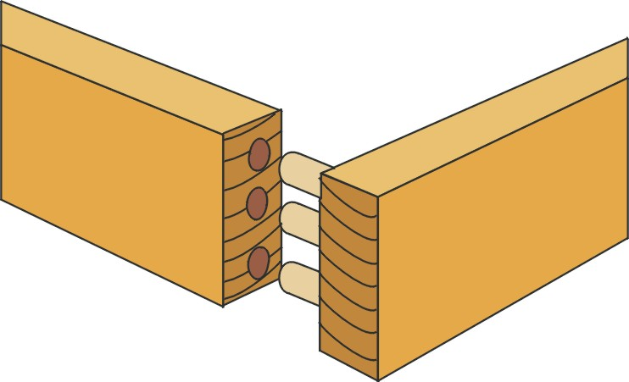
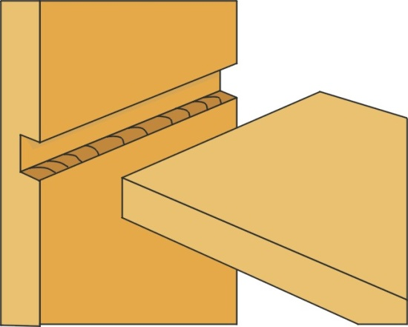
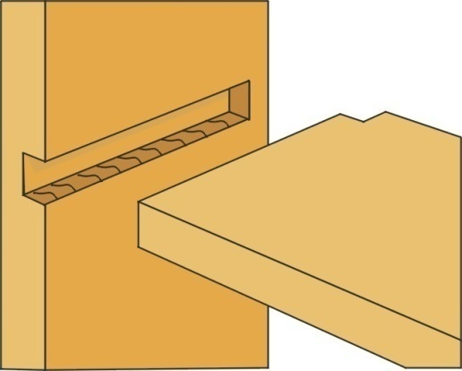
Dowelled Joint
These joints are both neat and strong. The holes must be lined up exactly but this can be done using a dowelling jig. The dowel will have a groove in the length so as to allow excess glue to escape.
Through Housing
These joints are simple to make and are suitable where the two parts being joined together are the same width.
Stopped Housing
These are harder to make, but are neater because the joint does not show on the front edge.

Slide 11
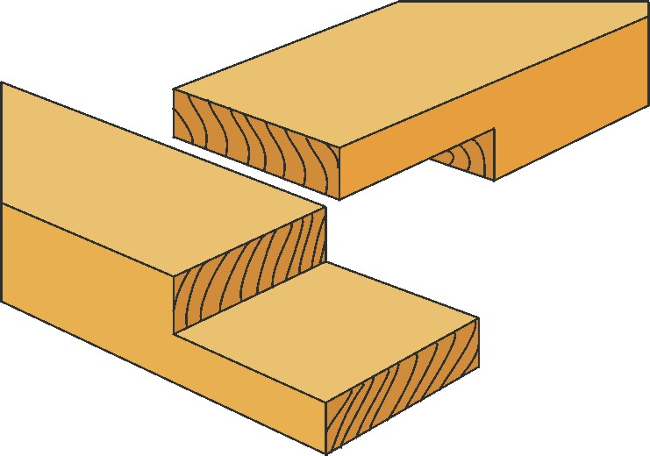
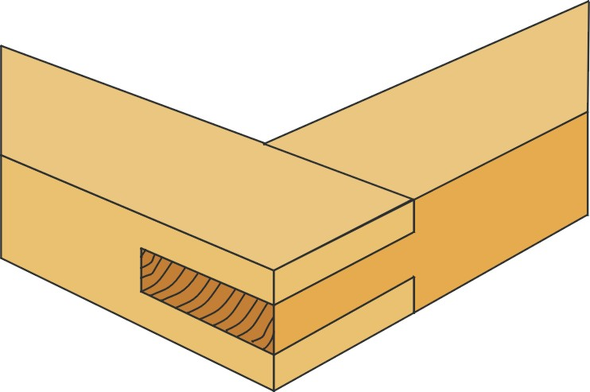
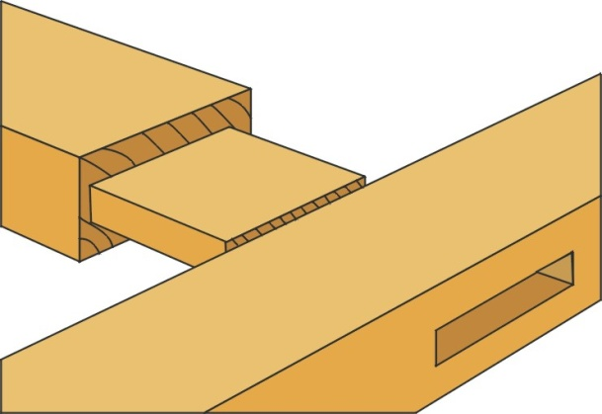
Corner Halving Joint
This joint is stronger than the butt joint and is also simple to make, but still needs strengthening with screws or dowels.
Corner Bridle
This joint is strong and fairly easy to make. They can be strengthened by dowels.
Mortise & Tenon Joint
The mortise & tenon joint is the strongest tee joint and can be further strengthened by wedging or dowelling.

Slide 12
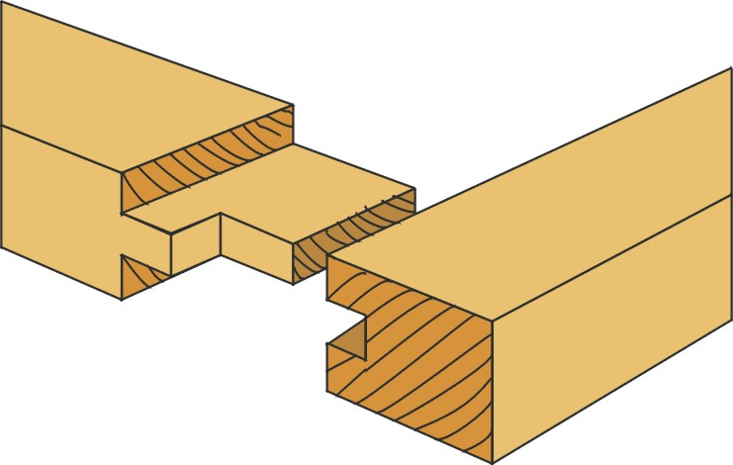
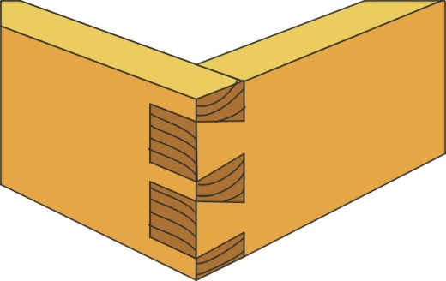
Haunched Mortise & Tenon Joint
This joint is used where the rail of a table will join into the top leg of the table. This could be regarded as a hidden joint.
Haunch
Dovetail Joint
This type of joint is very strong and can be only pulled apart in one direction. It is mainly used to construct drawers.

Slide 13
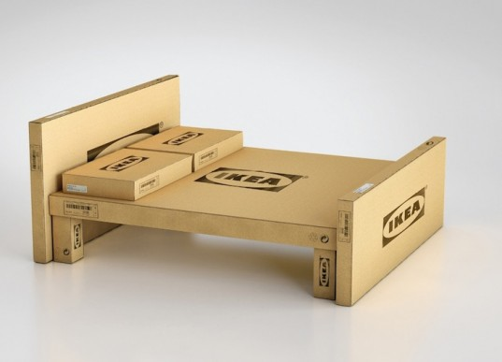
The World of Flat Pack
In today’s society, people want furniture that is cheap and easy to move. With more and more people living in flats and apartments it is difficult to haul large pieces of furniture up flights of stairs and through tight doors. Ikea is one of the most successful producers of flat packed furniture that comes in boxes which makes it easier for people to manoeuvre new furniture into their homes.
The only down side is that they have to put the furniture together once it is in their homes and they do not often have the tools that a Joiner would have to make the joins from the previous slides.....

Slide 14
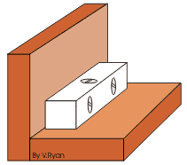
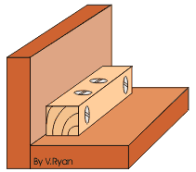
Knock Down Fittings
Knock-down fittings are joints that can be put together easily. Normally people only need a screw driver, a drill, a mallet/hammer or other basic tools to put them together. They are temporary joints although many are used permanently to join together items such as cabinets and other pieces of furniture that are purchased in a flat pack.
Plastic corner Block
Wooden corner Block
A piece of material such as pine can be drilled and screws can be passed through these holes.
The corner block is pressed against the two pieces of material
Screws are used to fix the block into position. This type of joint is used to fit modern cabinets such as those found in a kitchen. It is a relatively strong joint and it has the advantage that it can be dismantled using a screwdriver.
This gives a cheap and effective knock-down joint. The screws are normally countersunk into the knock-down fitting.

Slide 15
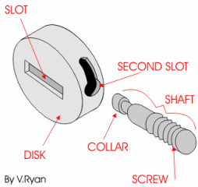
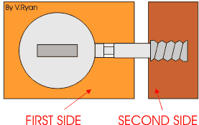
Cam Lock Fittings
The disk fits into a recess in the first side of the cabinet. It rotates by inserting a screwdriver into the slot in its side. The shaft is screwed into the second side of the cabinet. The collar of the shaft is passed through the hole in the second slot in the disk. When the disk rotates the shaft is locked in position. This keeps both sides of the cabinet locked together.

Slide 16
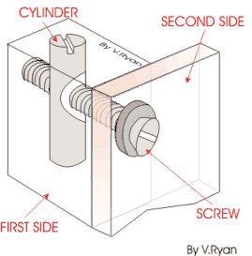
SCAN FITTINGS
These are strong enough to be either permanent or temporary joints. The cylinder is inserted into the first side of a cabinet in a pre-drilled hole. The screw is then pushed through the hole in the second side until it meets the cylinder. It can then be tightened with a screw driver until both sides of the cabinet pull together.

Slide 17
Applying a Finish
Always sand in the direction of the grain.
Before applying a finish it is important to make sure that the surface is very smooth and free from blemishes (marks and scratches) by firstly using an appropriate plane or scraper and then different grades of abrasive paper/sand paper in the direction of the grain. Sanding across the grain makes more scratches rather than making it smooth.
Sequence to applying varnish to a piece of wood
1. The Smoothing Plane (Smaller brother of the Jack Plane) is used first to remove pencil lines and any major blemishes.
2. Next, use a Medium grade of sand paper sand all surfaces.
3. The next stage is to apply a fine sprinkle of water over the surface of the wood. This raises the grain in the wood which when dry will be sanded off using a Fine Graded sand paper. This technique gives a better overall finish.
4. Using a Fine Graded sand paper sand down all surfaces.
5. Apply first coat of varnish. Allow to dry.
6. Using a Fine Graded sand paper sand down all surfaces.
7. Apply second coat of varnish. Allow to dry.

Slide 18
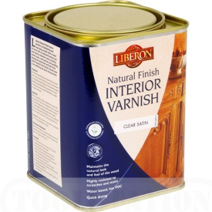
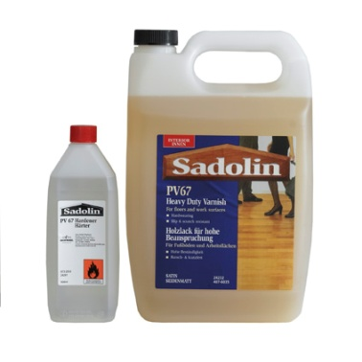
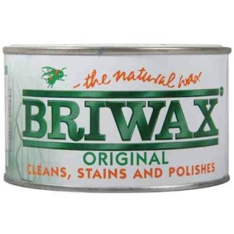
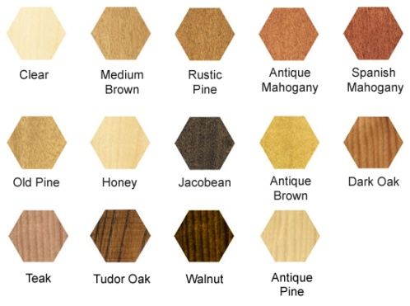
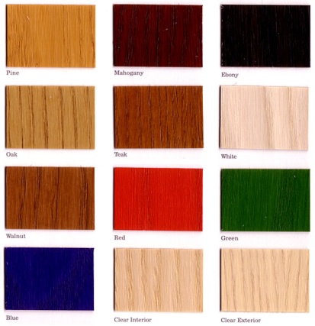
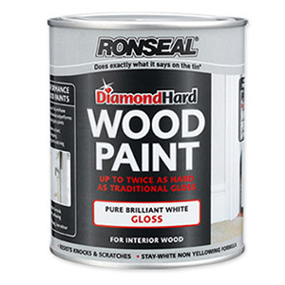
Types of finish available
1.
2.
· Water Based Varnish
· Spirit Based Varnish
· Wax Polish
· Coloured Wax Polish
· Danish Oil
· Coloured Stains
· Paints
3.
4.
5.
6.
7.

Slide 19
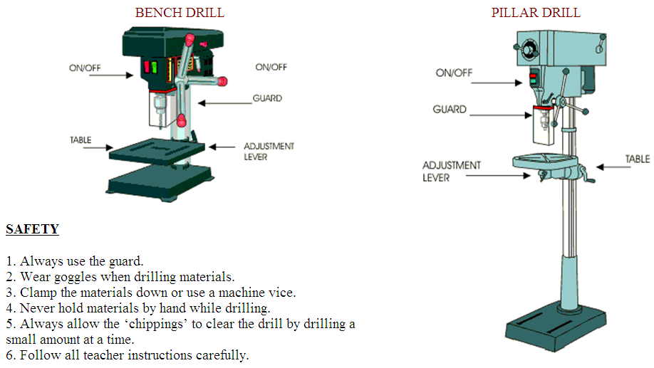
Machine Tools - Drills

Slide 20
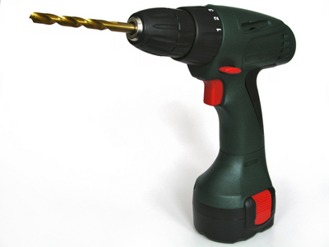
Machine Tools - Drills
Cordless Drill This does the same as the bench and pillar drill, but because it is not attached to anything it can drill holes in more awkward areas. This can also be used as an electric screwdriver if the drill bit is changed for a screw bit.
Drills Bits

Slide 21
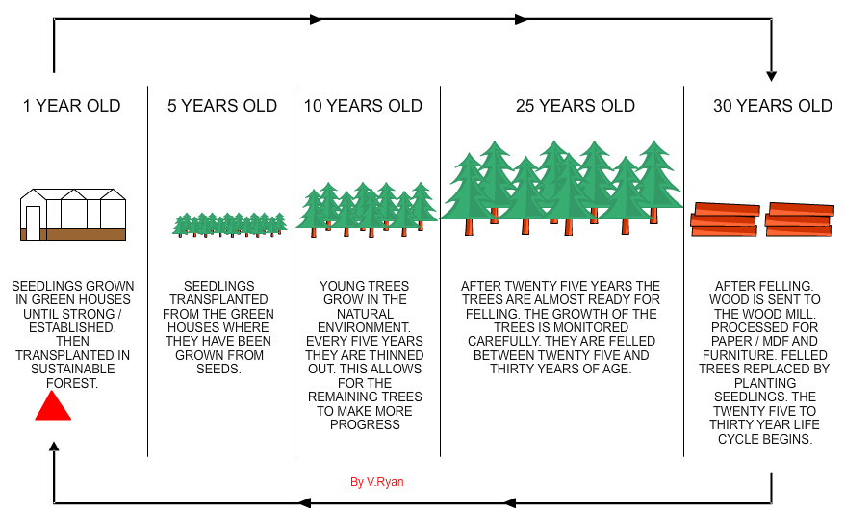
Sustainable Forrest Lifecycle
The forest is a working environment, producing wood products such as wood pulp for the paper / card industry and wood based materials for furniture manufacture and the construction industry. Great care is taken to ensure the safety of wildlife and to preserve the natural environment. Sustainable forests are the result of a commonsense policy to replace trees that are felled so that forests continue to exist providing natural materials for us all.

