Slide 1
Design
Design and manufacture
Name: ………………………………………………………… Class:……………… Teacher:…………………………………………..

Slide 2
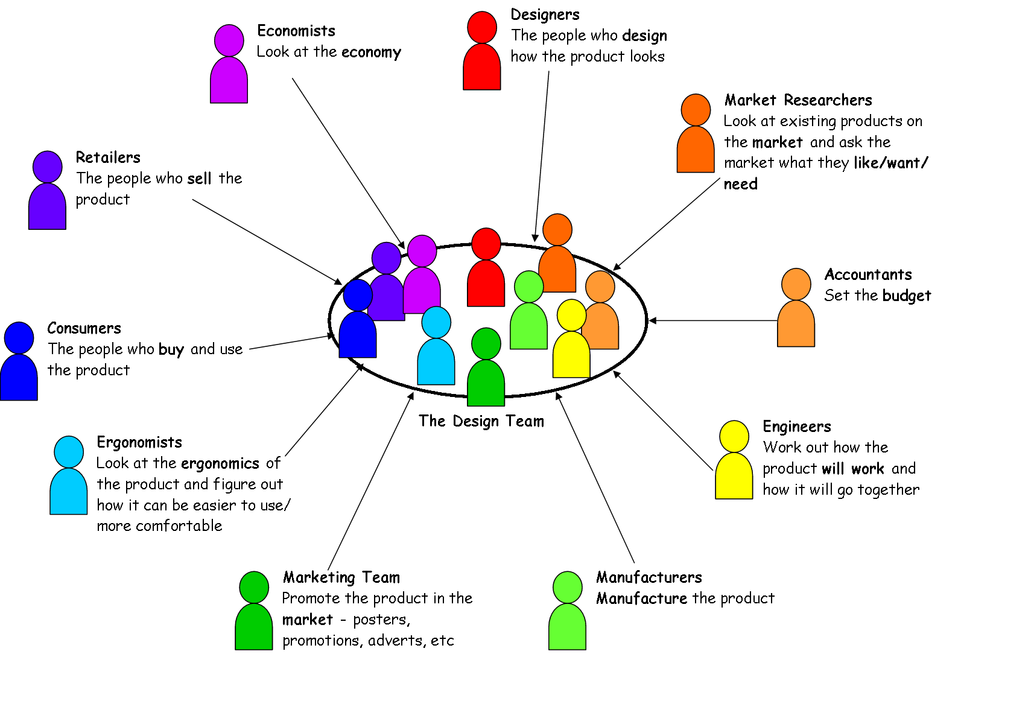
Design Team
A design team is a group of people, brought together to design a product. Each member of the design team will have certain skills or experiences which will allow him or her to specialise in one aspect of the design. Each member of the design team will then have responsibility for a certain part of the design.

Slide 3
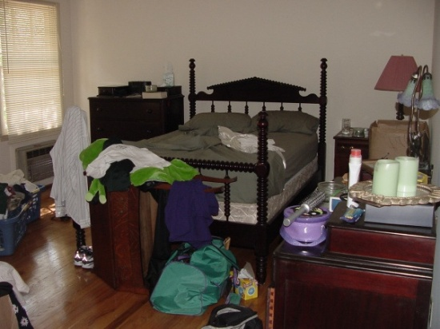
Problem Identification
Problem identification is finding opportunities to create new designs. This means finding out what needs a person, or group of people, has, in order to design a product to fulfil that need. Once a problem has been identified, a brief can be created to allow a designer to solve the problem.
Methods of problem identification
Situation analysis identifies problems by looking at a scene and analysing ways that the situation could be improved.
One way of doing this would be by taking a snapshot picture of a scene and using it to show problems. Describing in as much detail as possible the things that are happening in the snapshot breaks down the overall scene and suggests ways in which the whole situation could be improved.
Example of Situation Analysis
Situation—Messy bedroom.
Analysis—This untidy bedroom makes it difficult to
find things or get to the bed. Clothes and grooming
items are strewn across the room. Clothes are also piled
near the heater which may be a fire hazard. There is
limited floor space. There is nothing hanging on the
wall.
Possible Brief—Design a storage wall mounted system
that would allow a variety of items to be stored neatly.
Product Evaluation
Product evaluation tests existing products and tries to find weaknesses in the product’s design. All aspects of the product will be looked at including function and performance, durability, material choice, manufacturing and assembly methods, ergonomics, aesthetics, and economics.
Once a weakness has been found, a brief can be created to allow the designer to redesign and improve the product.

Slide 4
Design Brief
A design brief indicates what task is to be undertaken by the designer or which problem is to be solved by the designer.
It is usually set by the client, and may take different forms: written or verbal.
The design brief will set out the overall design goal of the project, any major constraints (time, budget, manufacturing or material limitations) and may include some success criteria which will be used to judge how successful the design has been (sales targets).
What information should be included in a Brief?
In its simplest form, a Brief should include two pieces of information: the Statement of Problem and the Target
Market.
The Statement of Problem is a sentence, or short paragraph explaining what the problem is that has to be
solved.
The Target Market is an explanation of which market group the product is aimed at or who will benefit by the
solving of the problem.
Examples of Design Brief
DESIGN BRIEF: Design a pot handle that remains
cool when the pot is heated. The users will be adults
Problem: The handle of a pot becomes too hot to hold
when the pot is heated.
Target Market: people over 16 years of age.
DESIGN BRIEF: Design a game of dominoes that can be played by blind people.
Problem: Blind people cannot play many of the indoor games available to sighted people.
Target Market: Visually impaired people

Slide 5
Design Analysis
Product Analysis is the process of identifying, looking at or disassembling a product and identifying its main features. The aim is to understand more about a product and improve it in the future. Many design factors influence the development of a product, some are listed and explained below.
Function
What the product must do. All products have a primary function and some also have secondary functions, i.e. they do something else or can be used for something else other than their primary function.
A product must do the job it was designed to do (sometimes called the fitness for purpose); if it fails to do this, the user may become frustrated with it.
Material
What the product is made from. The choice of material for a product will have an effect on several aspects of the design.
The manufacturing processes that can be used.
The cost of the product
The strength of the product
Aesthetics
Is concerned with the appearance of a product. This is a very important factor with regards to selling a product because it is literally the first thing the consumer sees.
Every product has aesthetic qualities that can be examined in depth.
Shape Proportion Size Colour
Contrast Harmony Texture Line
Ergonomics
Ergonomics is the study of how humans interact with their environment and the products they use.
It can be sub-divided into three main areas:
Anthropometrics – the study of human body sizes
Physiology – the study of human body systems, like strength, eyesight or hearing.
Psychology – the study of how the human mind perceives the environment.
Safety
Safety means designing a product, so that it does not harm the user, others, the environment or become damaged during use so that it could cause harm.
Environment
Designers must consider the environmental effects of products. The use of sustainable materials, the pollution and waste generated through manufacturing and recycling are all important issues to be considered.
Performance
In Performance we must consider
Durability Ease of Maintenance Ease of use

Slide 6
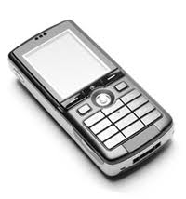
Function – Fitness for Purpose
Function Task 1
A mobile phone’s primary function is as a telephone (to make phone calls). List as many other possible secondary functions of a mobile phone as you can think of.
Secondary Functions of mobile phone.

Slide 7
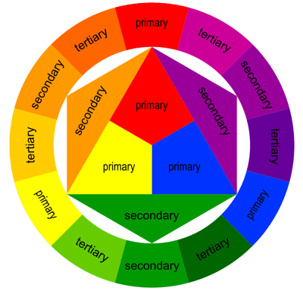
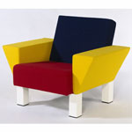
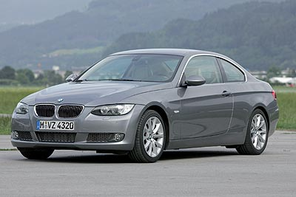
Aesthetics
Colour and Shape
· The two aesthetic properties that are easiest to understand.
· Both colour and shape can be used to create contrast or harmony.
· Colour can be used to target specific markets i.e. bright colours would be used for children's toys, sophisticated colouring for high class products and so on.
Harmony
· This is where parts of a design work well together or the design fits in with a specific environment
· It creates a sense of peace of relaxation.
· Simples shapes and colours that work well together should be used to achieve this.
Texture
· Different textures can makes designs look more stylish or interesting. Effects such as glass, concrete, wood grain, hard, soft, glossy (shine), matt (flat dull colour) and so on.
Contrast
· The opposite of harmony where designs are made to stand out and be bold.
· This can sometimes make a design more eye-catching.
· Contrast can be created using colours which are opposite each other on the colour wheel, circle and square shapes in a design, large and small, etc.
Proportion
· Small changes to the proportion of a shape can make it look more elegant, classy, stable or sleek.
· This example of a 1980’s BMW 3 series and a modern 2007 BMW 3 series shows how simple changes to shape can make designs more modern, sleek and elegant.

Slide 8
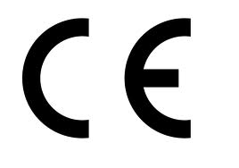
Safety
Why is safety important?
Unsafe products have the potential to cause harm through injury and legislation forbids or restricts their sale. All
products are required by law, to meet safety standards, and cannot be sold if they do not meet those standards.
Products will often display symbols to show compliance with safety legislation. If, after being sold, a product is
found to be unsafe, the product would be recalled and some form of compensation made to the consumer. Recalling
a product is very expensive for a company to do.
Safety is also seen as a major selling point for many products. For example, cars are often advertised by
highlighting their safety features. A consumer is more likely to buy a product which has additional safety features.
Many products are created to fulfil a specific safety need. For example child seats for cars, or bicycle helmets are
created to protect the user in the case of an accident. Designing safety products is an example of niche marketing.
How can I research and evaluate product safety?
All products sold must pass safety standards, and many will have symbols on them
which show the consumer that they have been approved by the relevant organisation.
These symbols are often found on a sticker or moulded onto a product, or printed in
the product’s instructions.
British Standards Institute (BSI)
The BSI set and check standards for all products sold in
Britain. Products which meet the standards are awarded
the BSI Kitemark.
European Community
The CE symbol indicates that the product has met
European regulations and can be sold across Europe.
BSI Kitemark.
CE Symbol

Slide 9
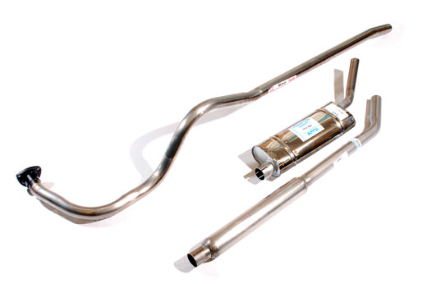
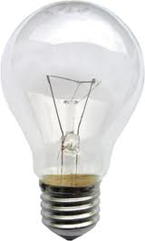
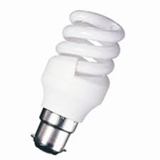
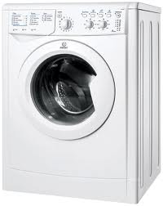
Performance
When looking at the Performance of a product it is important that we consider the following issues:
Durability, Ease of maintenance, Strength, Ease of Use
Durability
Durability is the life expectancy of a product, or how long it is expected to last. This is decided by the materials that the product is made from and Planned obsolescence. Planned obsolescence is the usable lifespan that a product has before new advances in technology, fashion or worn parts means that it is no longer desirable to keep the product functioning.
Eg 1. A car exhaust is normally made from mild steel which will eventually rust and need replaced after several years. But the exhaust could be manufactured in Stainless steel which will last a great deal longer, but will be more expensive to purchase and will mean that the manufacturers will not sell as may spares.
Eg 2 Traditional Light bulbs are expected to last no more than six months in normal use. But new low energy light bulbs which are more expensive can last for years.
Eg 3 Washing machines are designed to be replaced after about six years, this allows the manufacturer to constantly sell new models, bringing in more business by continuing to satisfy the buyer’s desire to have the latest, most fashionable model.

Slide 10
Performance
Planned obsolescence Task 1
Mass produced cars have built-in obsolescence.
Explain the implications of this for the consumer and the manufacturer.
List two other products which you consider to have built-in obsolescence.
Often similar products are available with different life expectancies. Consider and compare the following for different ends of the market:
• Cars
• Razors/shavers
• Pens

Slide 11
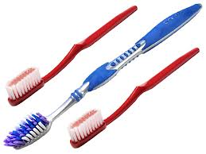
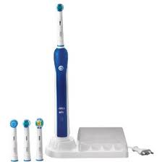
Performance
Ease of maintenance
Ease of Maintenance is how difficult it is for a user to keep a product in good working order throughout its life.
A cheaper product is probably intended to be thrown away after use and will need no maintenance.
A more expensive product is likely to last much longer and will require periodic maintenance to keep it in good order.
The complexity of a product will have a direct effect on the amount of maintenance required. A very complex product like a car will require a great deal of maintenance in its lifetime, from the regular servicing of the engine to ensure oil and water levels are correct to the replacement of worn parts like brake disks to prolong the life of the car.
These disposable toothbrushes are
designed to be thrown away once the
heads are worn out. There is no design
for ease of maintenance required and
their price is fairly low.
The oral-B electric toothbrush is designed to have a replaceable head, so that a consumer does not have to buy a whole new toothbrush each time the head wears out. This increases the initial cost of the product as there are additional components required to enable the head to join to the body, but allows the main body of the toothbrush to be used for a long time. Consumers would not buy the Oral-B at all if they needed to replace the whole product as often as they replace a fixed head.

Slide 12
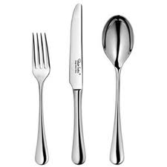
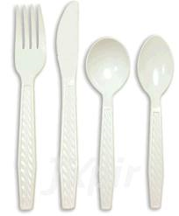
Materials
Materials
When coming up with a design for a product we must consider how many are to be produced, who the target market is, what the product is going to be used for, how and where it is to be used. When we have established all of this it becomes easier to decide which materials would be most suitable for the job.
In order to decide which materials to use we must have an idea of what properties we wish them to have.
For instance, a car wing-mirror must be waterproof, resistant to sunlight, impact resistant, chemically resistant and corrosion resistant. On top of this, the shape of the wing mirror must be able to be formed easily as it is a ‘mass produced’ product.
Choice of Materials will have a direct effect on several aspects of the design, including:
The manufacturing processes that can be used
The finishes that can be applied
The disposal of a product at the end of its life
The cost of the product
The lifespan of the product
The product’s performance in terms of strength, weight etc.
Cutlery made from stainless steel will be long lasting, corrosion resistant,
expensive and will require costly die cast moulds to produce.
Cutlery made from HIPS will be cheap, light, easily broken,
recyclable, will come in a range
of colours, and will require
injection moulding machinery to produce.

Slide 13
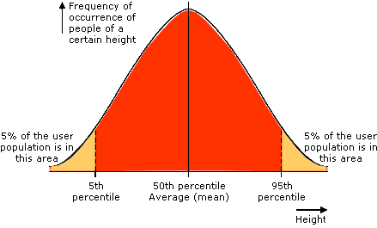
Ergonomics
Anthropometrics
Anthropometric information is the body size measurements of a person or group of people. The information is often displayed in the form of a table of body sizes, or as a diagram of a figure showing the body sizes as dimensions. The table will be specific to a target market, usually an age group or gender, with each line in the table representing a different body size measurement.

Slide 14
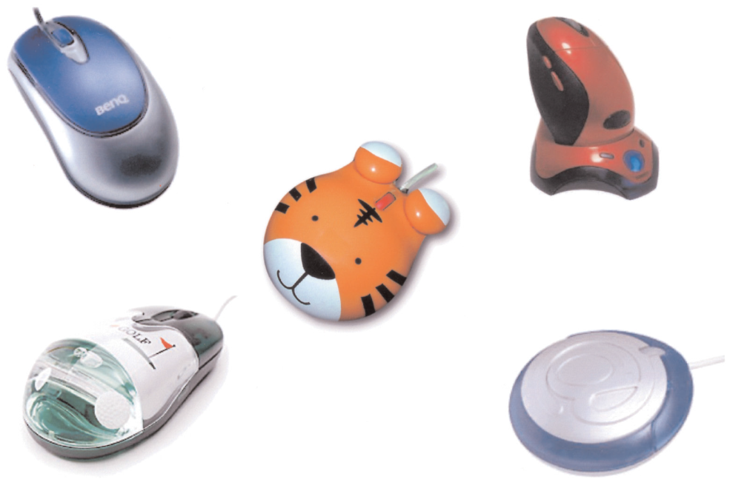
Design Factors
Task 1
Before producing a specification for a computer mouse, the designer would have researched various design factors.
With reference to computer mouse design:
state four design factors which would have been researched;
(b) explain why each of these design factors is important.

Slide 15
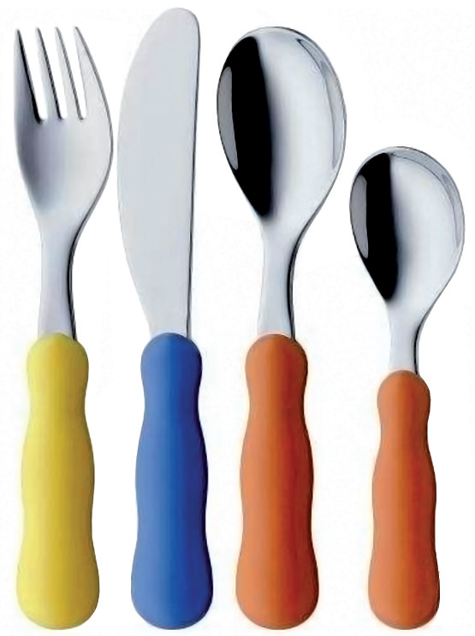
Design Factors
Task 2
Children’s cutlery is shown across.
During the design of children’s cutlery, the designer would consider the following areas:
Ergonomics Safety Aesthetics Materials.
Explain why each of these areas is important in the design of children’s cutlery.

