Slide 1
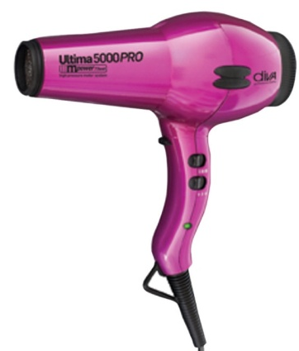
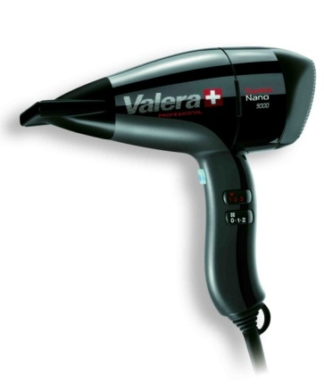
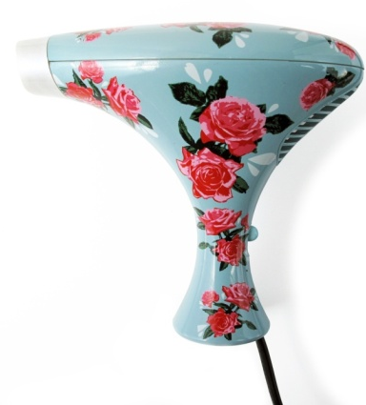
Evaluating Existing Products
Design & Manufacture

Slide 2
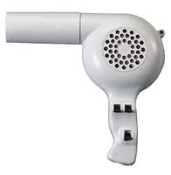
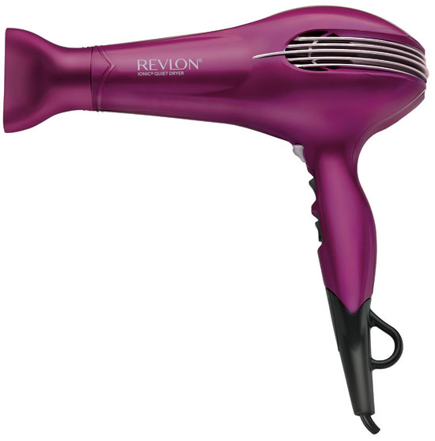
Why do we Evaluate products that are already on the market?
When designers are trying to design new products to put on the market, it is very important for them to look at other products that already exist. By analysing current products, designers can develop and improve these products and learn lessons from earlier mistakes or design faults to make their designs better.

Slide 3
How do we Evaluate Existing Products?
There are a number of ways to evaluate existing products:
User Trails - where a group of users test/trail versions of products under controlled conditions and give their opinions on the products.
Focus groups - Small number of people (usually between 4 and 15, but typically 8) brought together with a moderator to focus on/discuss a specific product.
Questionnaires – a list of research or survey questions asked to a larger group of people, designed to extract specific information.
Test Rigs - test that are carried out to facilitate, identify and rectify any operational problems of a product before they are put into production. These are normally carried out on a prototype of the final product.

Slide 4
How do we Evaluate Existing Products?
Things that can be discussed when evaluating existing products:
Function – Primary and Secondary functions, is the product fit for purpose.
Performance – Is the product easily maintained, is it good/bad for the environment, does it use quality materials is it difficult/expensive to produce?
Market – Is this product what consumers are looking for, does it meet social expectations, does it have a niche market?
Aesthetics – factors that affect the way the product looks.
Ergonomics – Anthropometrics (Human Sizes), Psychology, Physiology.
Economics – Cost, safety, British Standards, value for money.

Slide 5
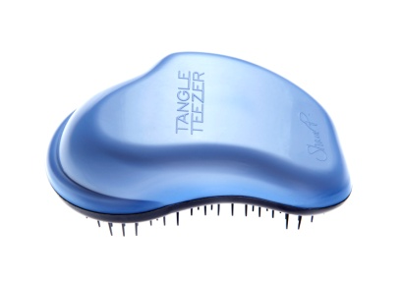
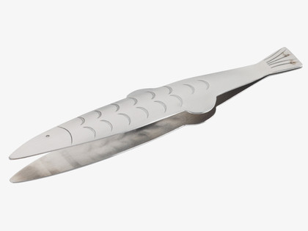
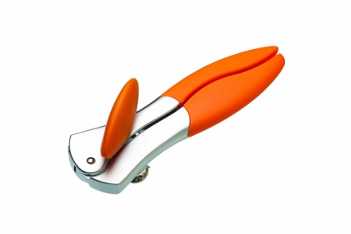
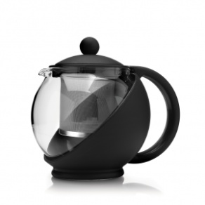
Your Task
You are going to be selecting an existing product of your own choice (no mobile phones/laptops/tablets etc) to evaluate and analyse.
Good products are things like tin openers, tweezers, salad tongs, cork screws, tea pots, hair brushes, toothbrushes, nail clippers etc. Things that you use everyday that have one or two specific functions
If you cannot choose an item before the next lesson you will have your product chosen for you out of the schools’ own collection of items.

Slide 6
Your Task
Once you have selected a product you will use the information given to you over the future lessons to evaluate and analyse your chosen product.
After you have collected all of the information you require you are going to produce a presentation/report on your findings on your evaluation of your product.
You may present your presentation using a PowerPoint presentation, a written report, a class talk with presentation etc.

