Slide 1
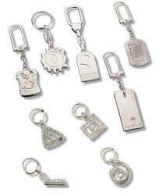
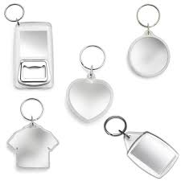
My Key Fob
Alix McAra
1.6

Slide 2
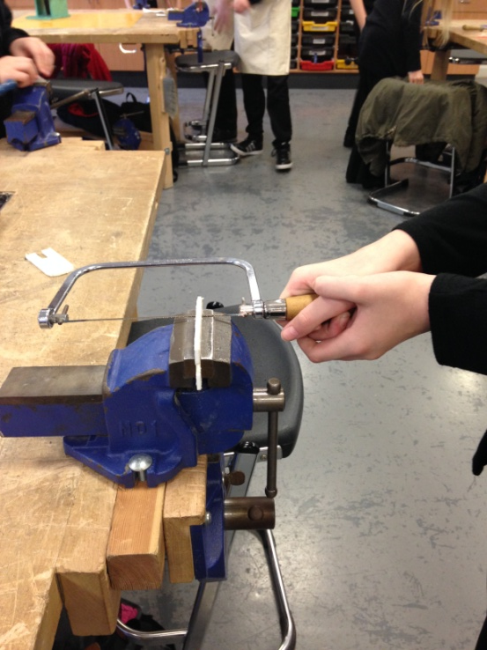
I started of my key fob by picking the plastic that I wanted to use and covered it with masking tape so that I could draw on the design that I had chosen and mark on the sizes, then I started to saw it out using a coping saw.

Slide 3
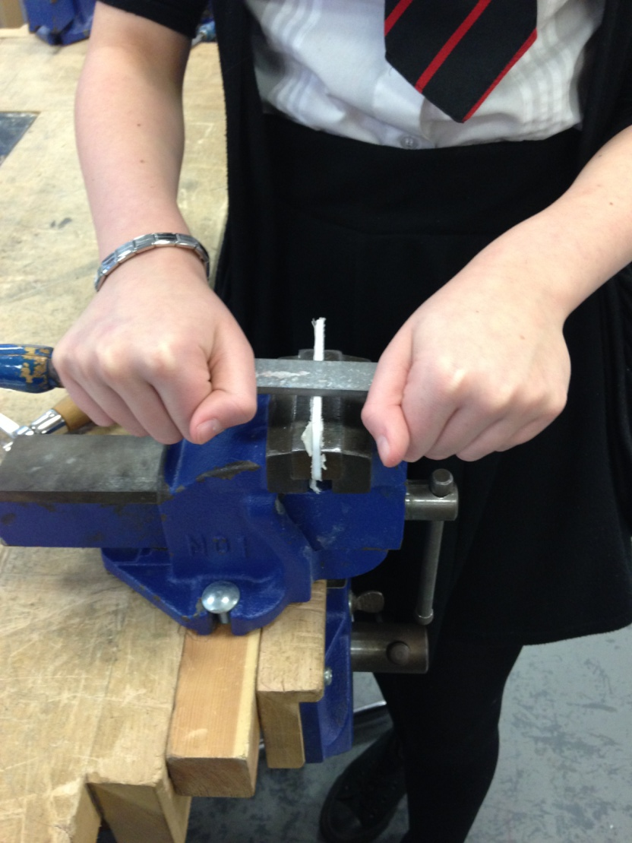
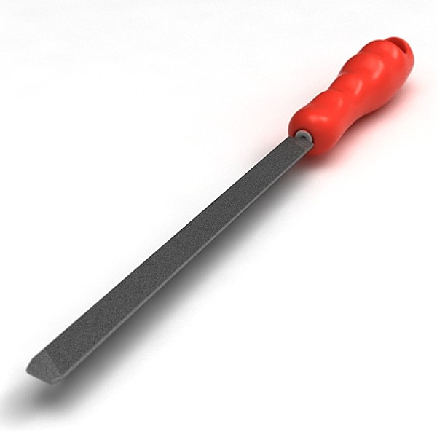
I then draw filed all the edges.

Slide 4
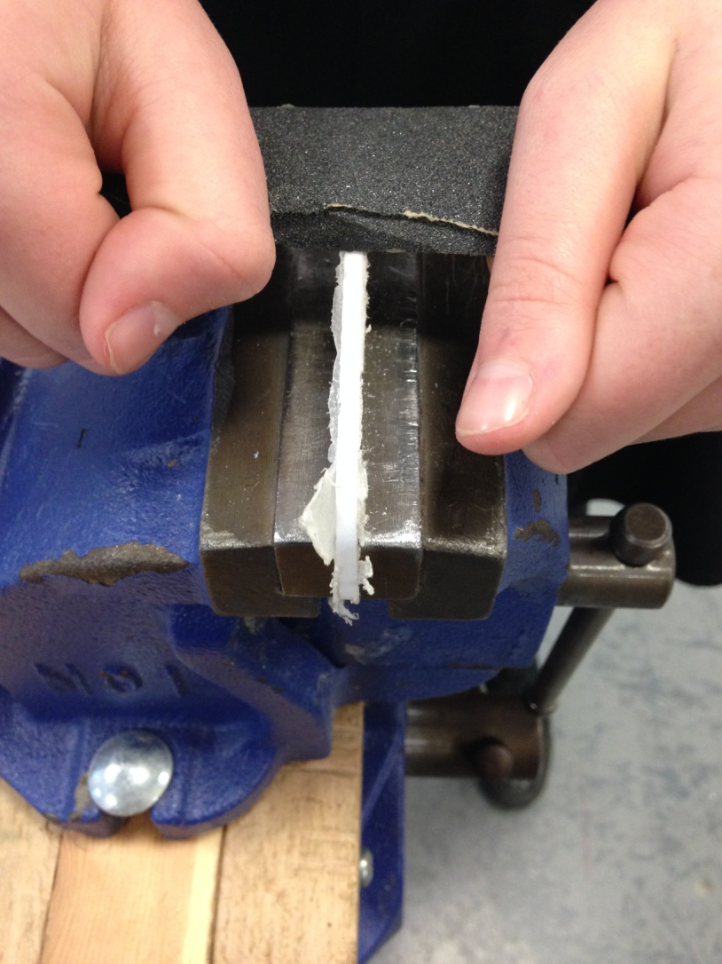
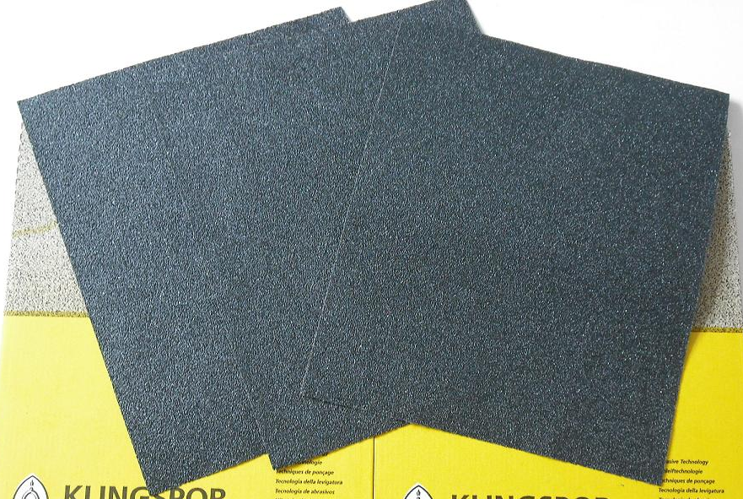
After that I used wet and dry paper to give it a smoother surface.

Slide 5
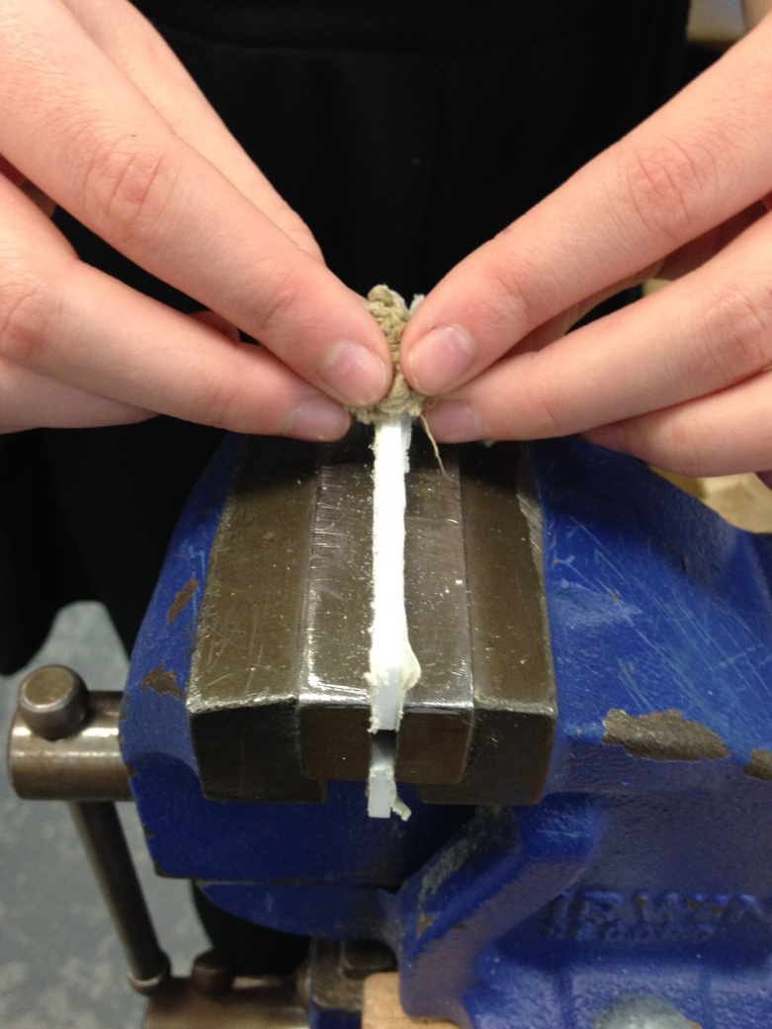
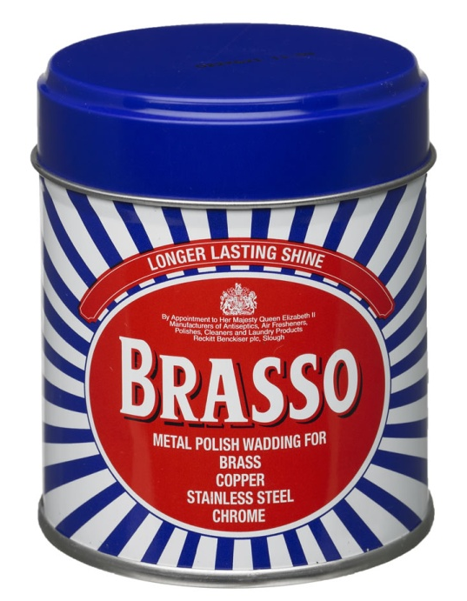
After the wet and dry paper I then rubbed brasso around the edges until it was shiny and even smoother.

Slide 6
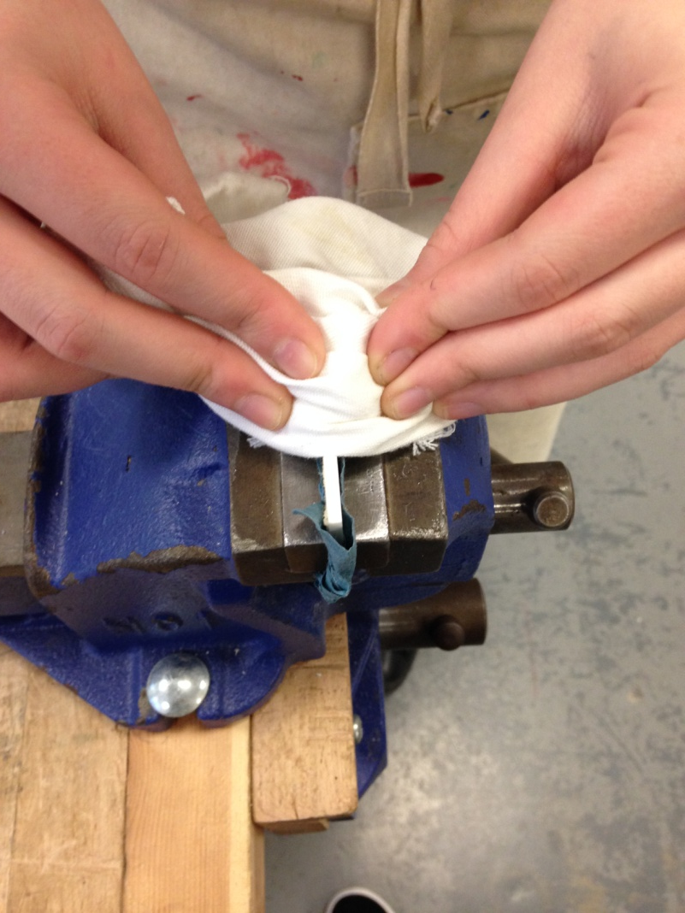
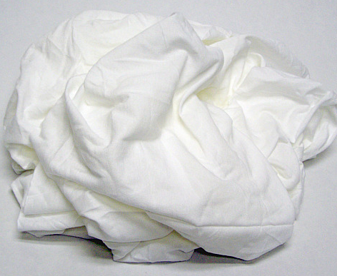
When the edges were smooth and shiny after the brasso I used a white cloth to rub the plastic to polish and dry it.

Slide 7
When I had finished polishing it I marked where I wanted the circle in the middle of my A to go and then drilled it slowly so that I didn't crack the plastic around where the hole was going to be drilled. After that I then marked where I wanted my key hole to go and then again I slowly drilled .

Slide 8
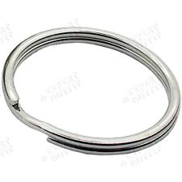
Lastly I chose the size of the key ring and put it through the hole I had just drilled.

Slide 9
My finished Key Fob

Slide 10
Thank You

